Slide 1
FAFF
Frequency-Aware Adaptive Filter Fusion
with Iterative Quality Optimization
Ajay Aravind Prakash
MS Computer Science · University of Wisconsin–Milwaukee
CS-712 Image Processing · Prof. Zeyun Yu · May 2026
🌐 faff-adaptive-image-enhancement.streamlit.app
CS-712 Image Processing | UW-Milwaukee | 2026

Slide 2
Problem Statement
🩻
⚠️
🎯
Medical Images Have Noise
Single Filter Approaches Fail
No Adaptive Optimization
X-rays, ultrasounds and MRIs contain sensor noise, speckle noise and motion artifacts that hide critical diagnostic details like tumor edges and vessel walls.
Gaussian blur destroys edges. Sharpening amplifies noise. No single filter can simultaneously denoise and preserve detail — each region needs different treatment.
Existing methods use fixed globally-tuned parameters. No system automatically discovers the optimal enhancement strategy per region based on local content.
CS-712 Image Processing | UW-Milwaukee | 2026

Slide 3
Algorithm — Step 1 & 2: Patch Division + FFT Analysis
1
Patch Classification & Starting Weights
Divide Image into Patches
Split the image into 16×16 pixel blocks. Each patch is analyzed independently — allowing different treatment per region.
High Frequency
Edge-rich
rib, spine, borders
2
Apply 2D FFT to Each Patch
Median: 15% Gaussian: 15% Sharpen: 70%
Compute the Fast Fourier Transform (Lecture 12) on each patch to convert from pixel values to frequency components.
Low Frequency
3
Measure Frequency Ratio
Smooth region
lung background
Calculate ratio of high-frequency energy (edges/detail) vs low-frequency energy (smooth/background) in each patch.
Median: 50% Gaussian: 40% Sharpen: 10%
4
Classify Patch Type
Mixed
High HFR → edge-rich region. Low HFR → smooth region. Mixed → balanced region. Each gets different starting weights.
Mid-complexity
tissue patterns
Median: 35% Gaussian: 35% Sharpen: 30%
CS-712 Image Processing | UW-Milwaukee | 2026

Slide 4
Algorithm — Step 3 & 4: Filter Fusion + Iterative Optimization
Three-Filter Bank
Median Filter
Gaussian Filter
Unsharp Masking
Noise Models
Smoothing
Sharpening
Removes salt & pepper and impulse noise while preserving edges — replaces each pixel with neighborhood median.
Low-pass filter that suppresses high-frequency Gaussian noise in smooth background regions.
Enhances high-frequency edge components. Subtracts blurred image from original to amplify edges.
Output = w₁ × Median + w₂ × Gaussian + w₃ × Unsharp where w₁ + w₂ + w₃ = 1
Iterative SSIM Optimization (Nelder-Mead)
1
2
3
4
Apply fusion
with current weights
→
Score with SSIM
(Structural Similarity)
→
Adjust weights
(Nelder-Mead)
→
Converged?
Use final weights
Repeat until SSIM stops improving
CS-712 Image Processing | UW-Milwaukee | 2026

Slide 5
FAFF — Complete Pipeline
1
2
3
4
5
6
7
8
9
Input
Noisy Image
Split into
16×16 Patches
FFT Frequency
Analysis
Detect
Noise Type
Content-Aware
Weights
Apply 3
Filters
SSIM
Optimize
Reconstruct
Full Image
Enhanced
Output
🔑 FAFF Innovation
•
FFT per patch —
Analyzes frequency content of each region — not the whole image at once
•
Content-aware weights —
Automatically derives starting weights from local patch statistics (variance, edge strength, frequency ratio)
•
Iterative optimization —
Nelder-Mead optimizer maximizes SSIM quality score per patch — no manual weight tuning needed
CS-712 Image Processing | UW-Milwaukee | 2026

Slide 6
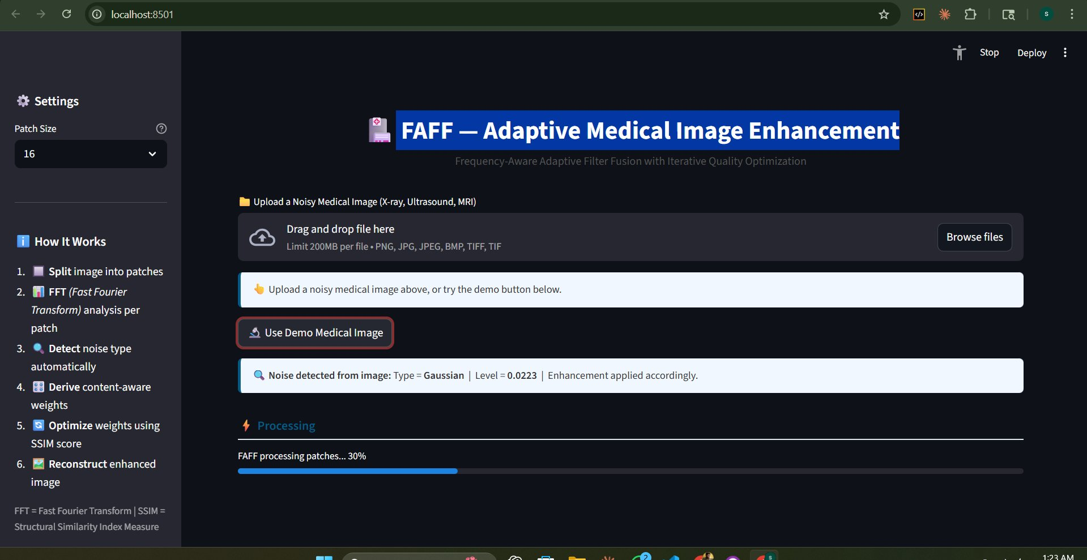
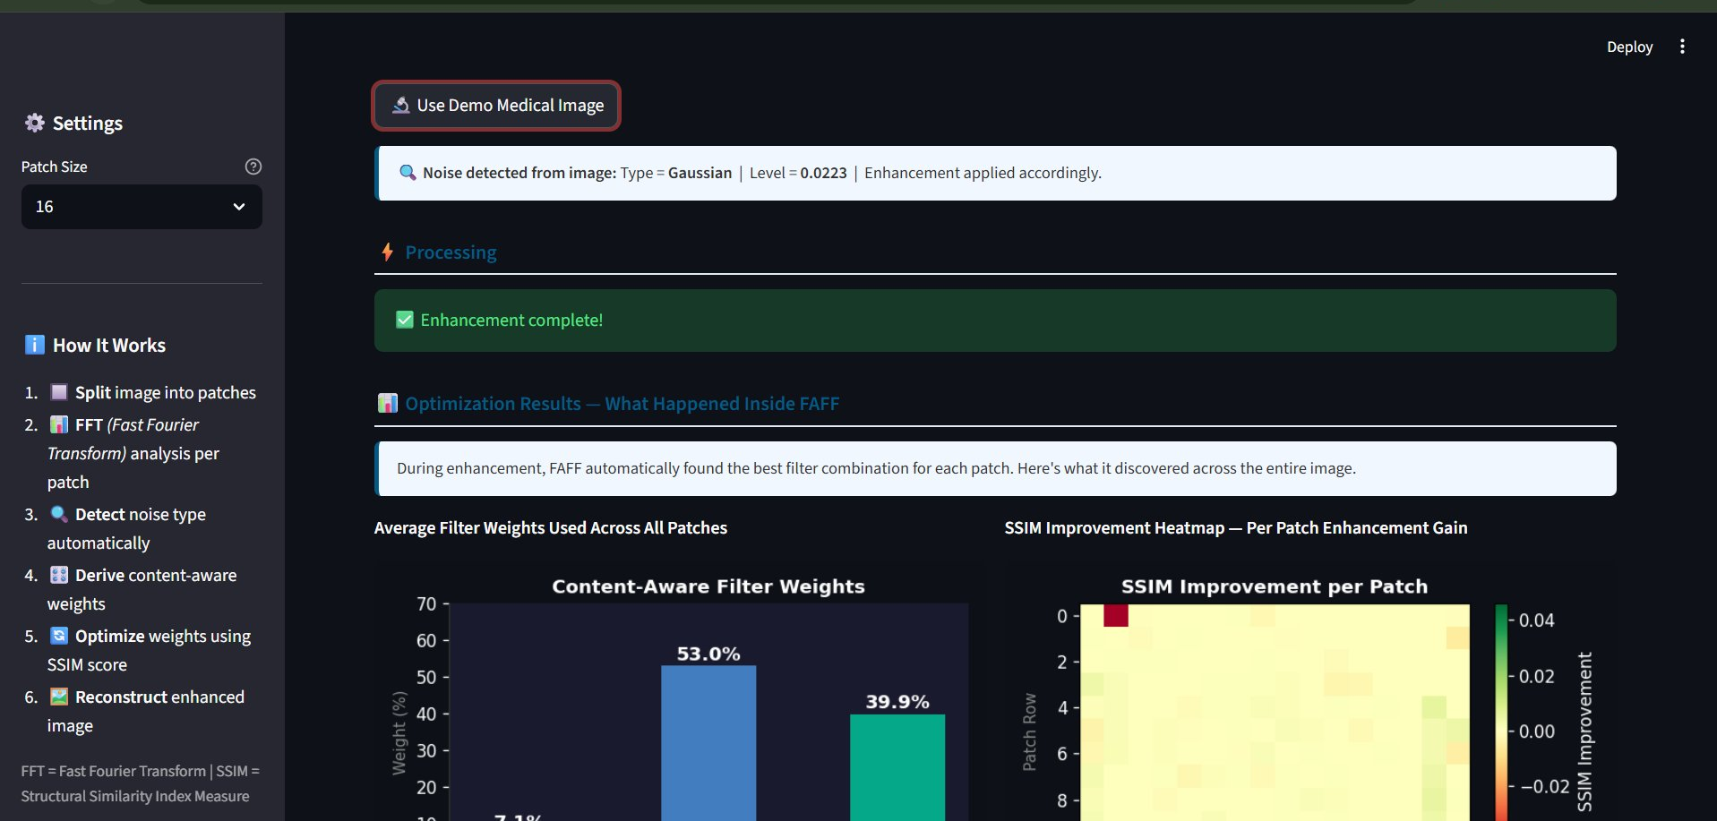
Live Demo — FAFF Web Application
Upload & Noise Detection
Optimization Results — Weights & Heatmap
Left: App auto-detects noise type (Gaussian/Salt & Pepper) and level from the real image. No manual settings needed. Right: After processing, shows average filter weights used across all patches and SSIM improvement heatmap per patch.
🌐 faff-adaptive-image-enhancement.streamlit.app
CS-712 Image Processing | UW-Milwaukee | 2026

Slide 7
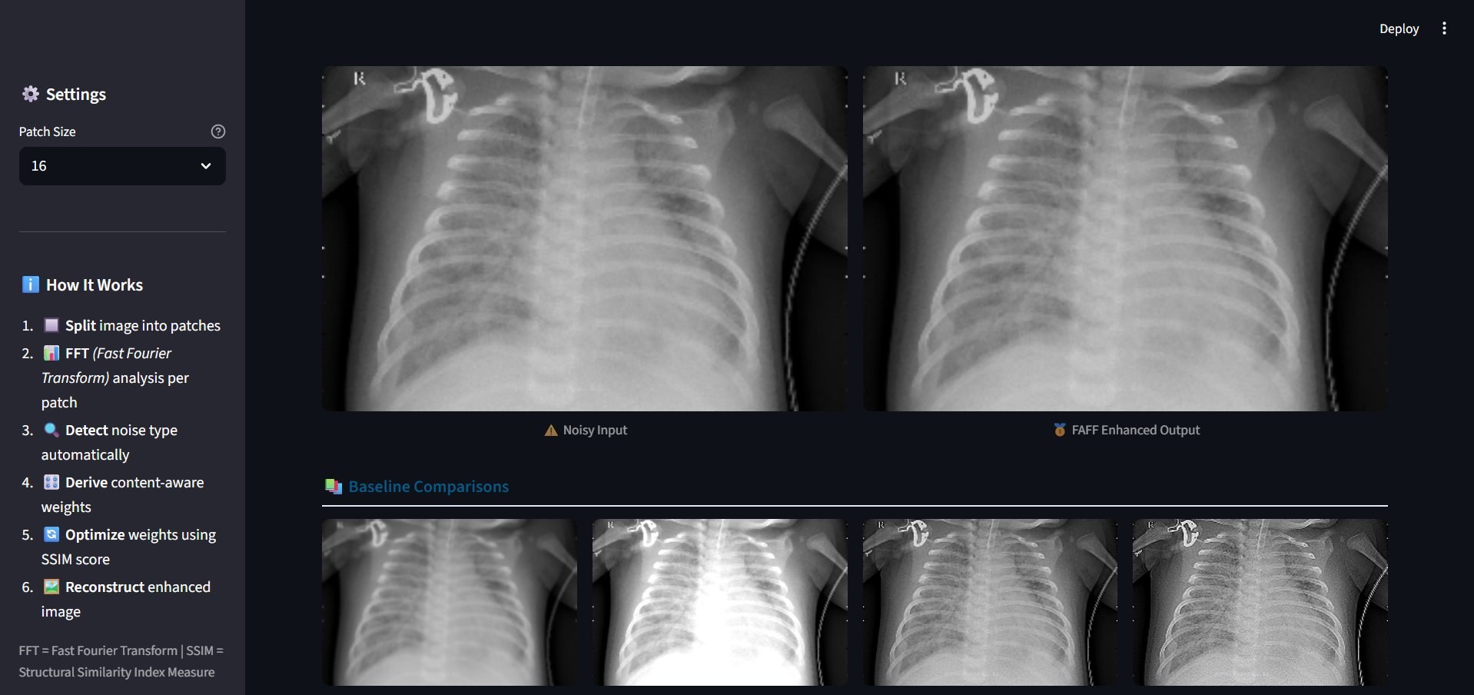
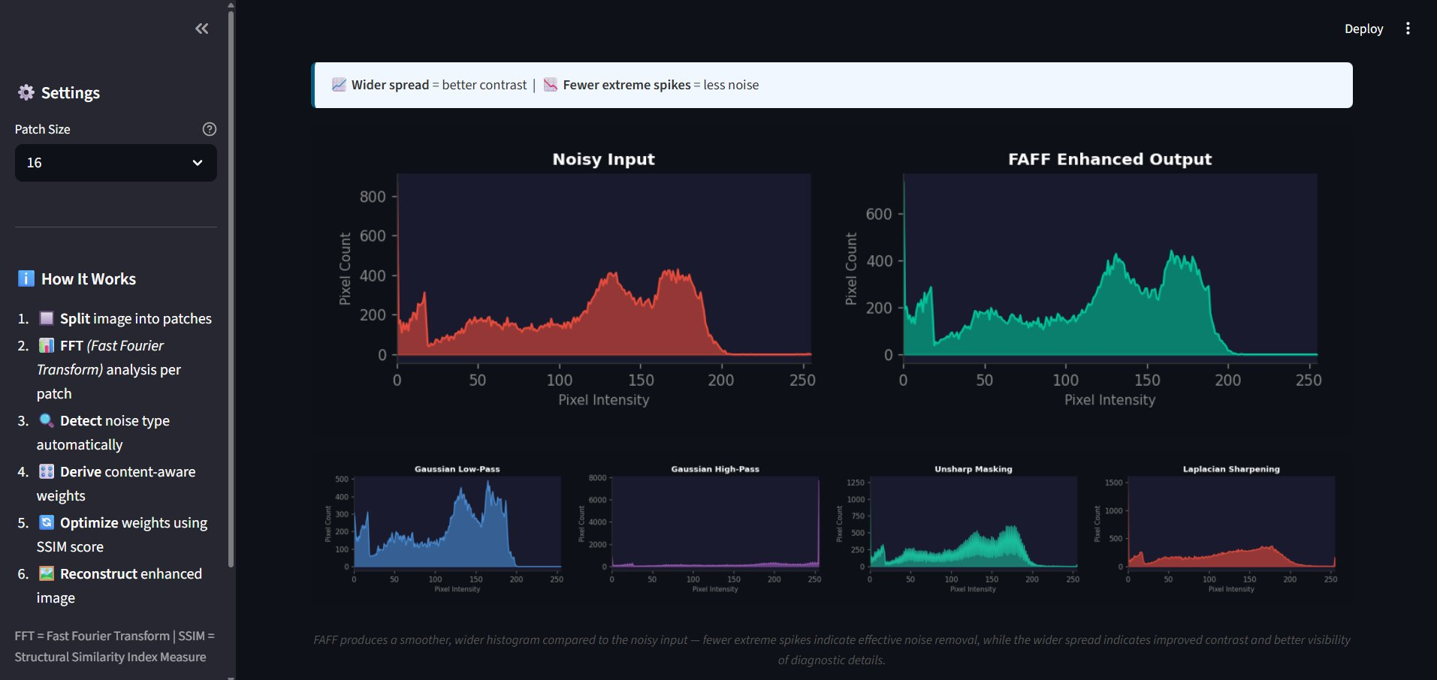
Live Demo — Results & Comparison
Noisy vs FAFF Enhanced + Baselines
Histogram Comparison
Left: Side-by-side comparison of FAFF output vs 4 baseline methods from course lectures (Lec 13, 14, 15, 19). Right: Histogram shows FAFF produces smoother, wider distribution — less noise spikes, better contrast.
🌐 faff-adaptive-image-enhancement.streamlit.app
CS-712 Image Processing | UW-Milwaukee | 2026

Slide 8
Results & Analysis
What FAFF Discovered
Visual Improvements
53%
Gaussian Smoothing
Noise Reduction
📉
Dominant weight — image has significant low-frequency noise in lung regions
Gaussian grain in lung background significantly reduced — cleaner tissue visualization
Edge Preservation
📐
40%
Unsharp Masking
Rib and spine boundaries remain sharp — critical for clinical assessment
High weight — rib and bone edges need significant sharpening
Detail Enhancement
🔍
Fine vessel patterns in lung tissue enhanced — improved diagnostic visibility
7%
Median Denoising
Low weight — minimal isolated pixel noise detected
Histogram Spread
📊
Pixel distribution wider and smoother — better contrast across intensity range
CS-712 Image Processing | UW-Milwaukee | 2026

Slide 9
Future Work & Real-World Applications
🔭 Algorithm Enhancements
🌍 Real-World Applications
🤖
Deep Learning Hybrid
🏨
Hospital PACS Plugin
Replace Nelder-Mead optimizer with a lightweight CNN that predicts optimal weights in a single forward pass — 10× faster
Auto-enhance every X-ray before radiologist review — seamless clinical workflow integration
🧊
3D Medical Volumes
📱
Portable Ultrasound Devices
Extend to MRI/CT scans — apply FFT analysis across depth slices for volumetric enhancement
Embedded chip implementation for rural clinic low-cost portable scanners
⚡
GPU Acceleration
💻
Telemedicine Platforms
Parallel patch processing using CUDA — enable real-time clinical use
Restore quality of compressed images sent over low-bandwidth internet connections
🎯
Disease-Specific Tuning
🔬
AI Diagnostic Pipeline
Train separate weight predictors for TB detection, breast cancer screening, pneumonia classification
Better enhanced images → higher accuracy for AI cancer detection and classification models
CS-712 Image Processing | UW-Milwaukee | 2026

Slide 10
Conclusion
✅
Built FAFF — a novel Frequency-Aware Adaptive Filter Fusion system for medical image enhancement
📊
FFT-based patch analysis classifies each region as high/low/mixed frequency before filtering
🎛️
Content-aware weight initialization derived from local statistics — no manual tuning required
🔄
Iterative Nelder-Mead optimization maximizes SSIM quality score per patch automatically
📚
All baseline methods directly from course lectures 12, 13, 14, 15, 19 — grounded in taught material
🌍
Deployed as a live web application with real-time noise detection and visual analytics
CS-712 Image Processing | UW-Milwaukee | 2026

Slide 11
References
[1] Gonzalez, R.C. & Woods, R.E. (2018). Digital Image Processing, 4th Edition. Pearson. [Course Textbook]
[2] Wang, Z. et al. (2004). Image Quality Assessment: From Error Visibility to Structural Similarity. IEEE Trans. Image Processing, 13(4), 600–612.
[3] Tomasi, C. & Manduchi, R. (1998). Bilateral Filtering for Gray and Color Images. ICCV, 839–846.
[4] Polesel, A. et al. (2000). Image Enhancement via Adaptive Unsharp Masking. IEEE Trans. Image Processing, 9(3), 505–510.
[5] Virtanen, P. et al. (2020). SciPy 1.0: Fundamental Algorithms for Scientific Computing in Python. Nature Methods, 17, 261–272.
[6] Al-Dhabyani, W. et al. (2020). Dataset of Breast Ultrasound Images (BUSI). Data in Brief, 28, 104863.
[7] Nelder, J.A. & Mead, R. (1965). A Simplex Method for Function Minimization. Computer Journal, 7(4), 308–313.
[8] Burt, P.J. & Adelson, E.H. (1983). The Laplacian Pyramid as a Compact Image Code. IEEE Trans. Communications, 31(4), 532–540.
CS-712 Image Processing | UW-Milwaukee | 2026

Slide 12
Thank You!
Frequency-Aware Adaptive Filter Fusion (FAFF) for Adaptive Medical Image Enhancement
Any Questions?
faff-adaptive-image-enhancement.streamlit.app
Ajay Aravind Prakash | CS-712 Image Processing | UWM | May 2026
CS-712 Image Processing | UW-Milwaukee | 2026

